Slide 1

INDUSTRY CONSULTATION SESSION
TRAINING ASSESSMENT POLICY
Mpumalanga Province
17 February 2021
Anna Tsele- Manager: Training

Slide 2

OVERVIEW
1

Slide 3
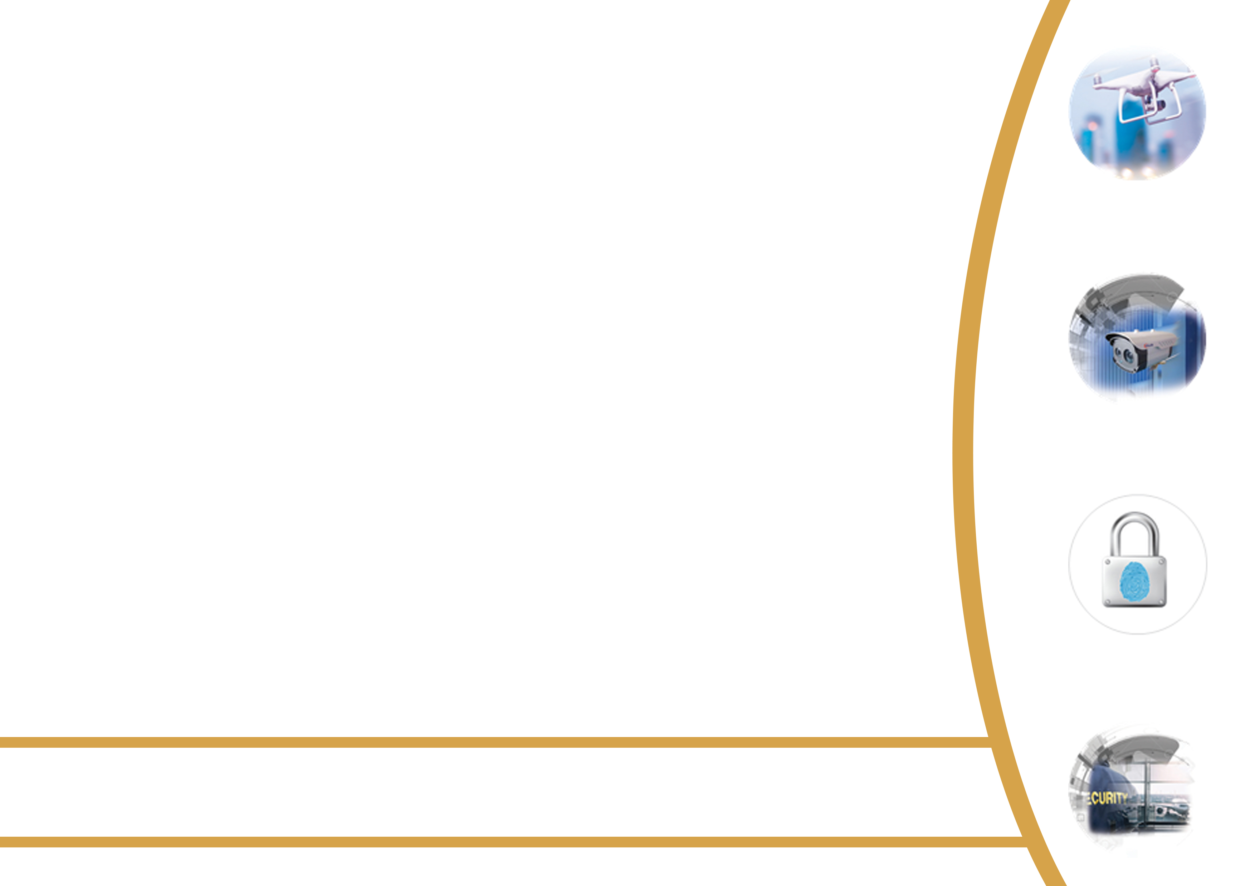





KEY DISCUSSION POINTS
Legislative Mandate
Policy Objectives
Key Stakeholders
Roles and Responsibilities
Awarding Competency
Irregularities

Slide 4

LEGISLATIVE MANDATE
2

Slide 5
LEGISLATIVE MANDATE
PSIR Act 56 of 2001
Accreditation and withdrawal of the accreditation of persons and institutions;
Monitoring and auditing of the quality of training functions performed by accredited person;
Participation in the activities of other bodies and persons entitled by law to set standards in respect of training of security service providers or bodies entitled to formulate, implement or monitor skills development for the private security industry;

Slide 6
LEGISLATIVE MANDATE (Cont.)
(iv) The appointment of persons to monitor and assess achievements or outcomes in respect of standards applicable to training;
(v) The determination and accreditation of qualifications required by security service providers to perform particular types of security services, and
(vi) The taking of reasonable steps to verify the authenticity of training certificates presented by persons for the purpose of this Act.

Slide 7
POLICY OBJECTIVES
3

Slide 8
POLICY OBJECTIVES
Creating national standard for accreditation for prospective and constituent Security Officers.
Establishment of Assessment Centres.
Promote credibility on internal assessments.
Coordinate Digital Assessments.
Ensure authentication of certificate issued

Slide 9
STAKEHOLDERS
3

Slide 10
KEY STAKEHOLDERS
All accredited security service providers
Security Training Providers (instructors and assessors);
Assessment Centres;
PSiRA Training Unit; and
Inspectorate in Law Enforcement.

Slide 11
OBLIGATIONS
3

Slide 12
ROLES & RESPONSIBILITIES
Proposed obligations assigned to different stakeholders:
Stakeholder Category | Responsibility
Accredited Training Centres | Enrolments Training Internal assessment and learner feedback
Assessment Centres | Resourced Structure for IT infrastructure for digital assessment
Instructors | Assessing instructed courses
PSiRA | Develop assessment questionnaires Create a Digital Platform for online assessments Issue and learner feedback Prosecute any irregularities
Learners | Register and attend courses Undergo assessments (Internal and External)

Slide 13
AWARDING COMPTENCY
3

Slide 14
AWARDING COMPETENCY
The pass mark for all assessments is 50%.
Re-assessment of learners with a scale below 50% will be granted two(2) attempts for re-assessment(s).
Qualifying learners should attain a scale of between 45%- 49%.
RPL candidates– those who attain 45%-49% shall undergo a gap training intervention in order to qualify for re-assessment.

Slide 15
IRREGULARITIES
3

Slide 16
IRREGULARITIES
Any event that will act as a compromise to the credibility of the assessment process will be classified as irregularity. Example:
  an act of dishonesty by a learner.
  negligence by instructors and assessors during, before and after preparation and administration of the assessments.
  negligence by instructors and assessors in reporting assessment outcomes.

Slide 17
Questions and/or Inputs

